Slide 1


HEART DISEASE
Artificial Intelligence
Final Project
Fall 2024
Presented by Roua Mohamad , Jana Dannawi and Hiba Wehbe

Slide 2

TABLE OF CONTENTS
01
05
02
06
03
07
Introduction
ID3
Evaluation
Problem Statement
Description of data set
Code
04
Training data and calculation
08
Conclusion

Slide 3

INTRODUCTION

Slide 4
01
Introduction

Slide 5
02
Problem Statement

Slide 6
03
Description of data set

Slide 7
Description
1.Dataset Overview:
2.Target Variable
4. Dataset Size
3.Features

Slide 8
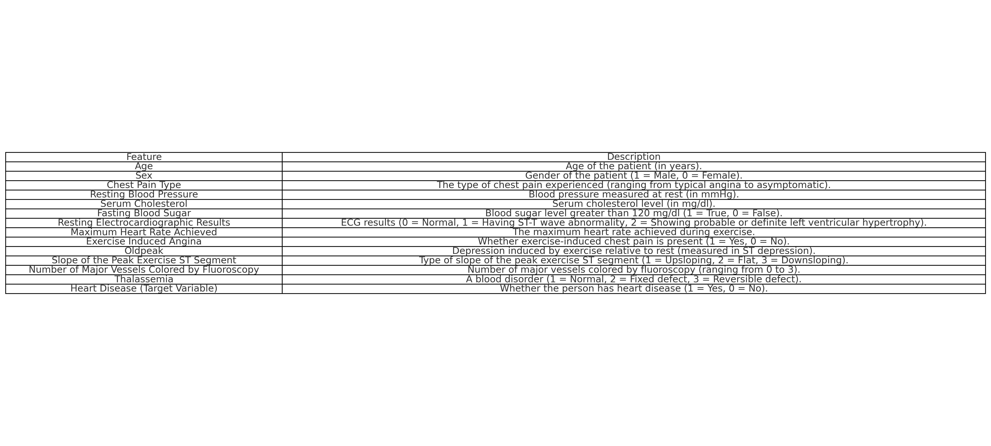
Independent variable

Slide 9
04
Training data and calculation

Slide 10
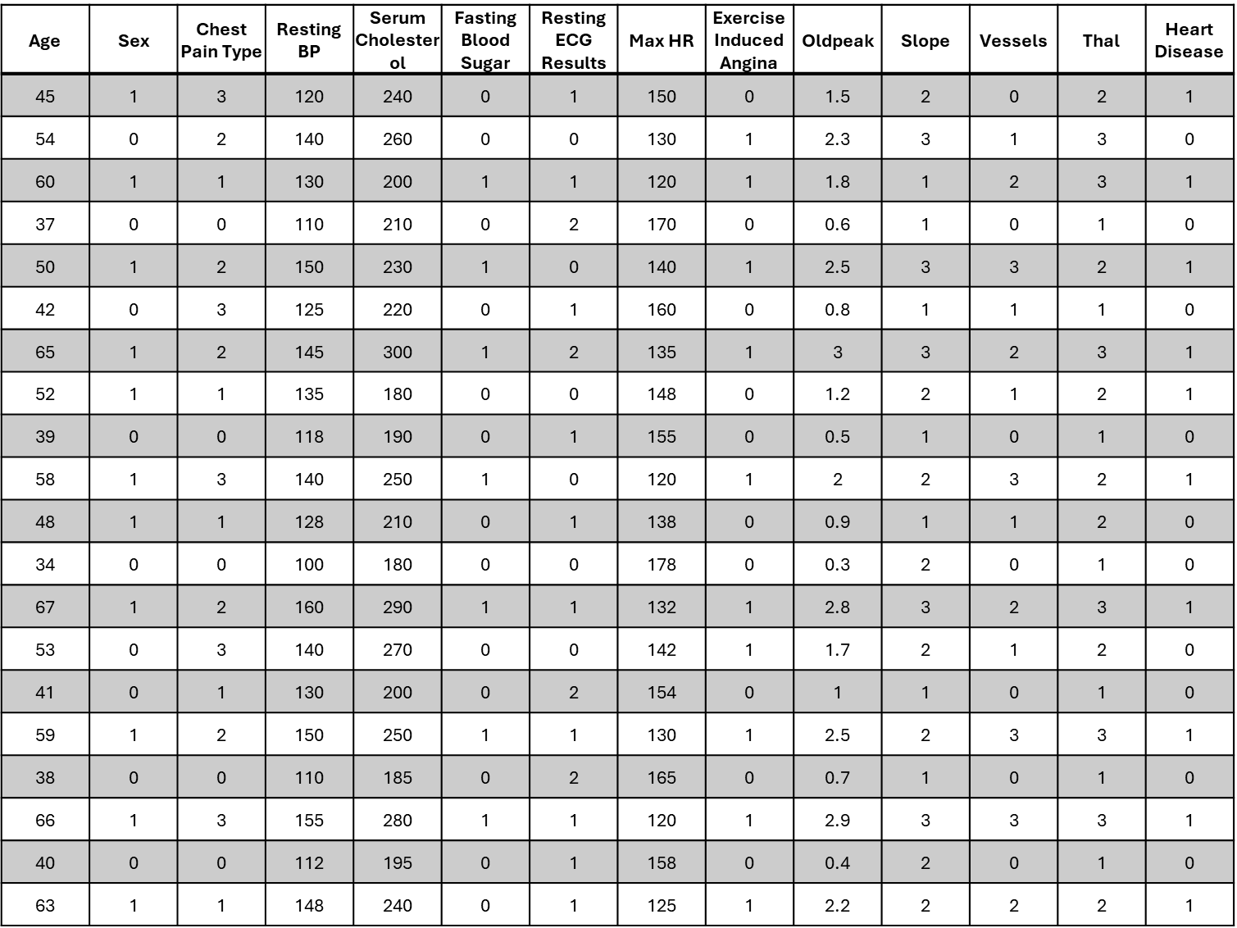
Training data

Slide 11
Calculation
Entropy
Information Gain

Slide 12

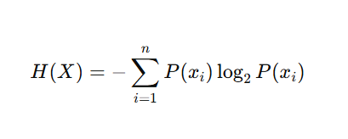
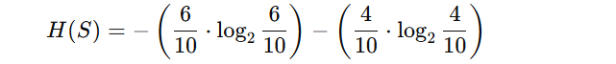
Entropy steps
Heart Disease = 1 (Positive Cases): 6 samples.
Heart Disease = 0 (Negative Cases): 4 samples
Entropy
Total samples = 10.
step1
Entropy is calculated using the formula

Slide 13

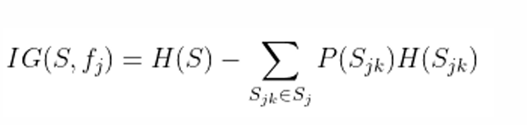
Information gain steps
Information gain
step2
Information Gain is calculated

Slide 14
05
ID3

Slide 15
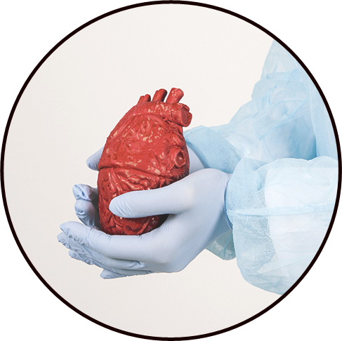
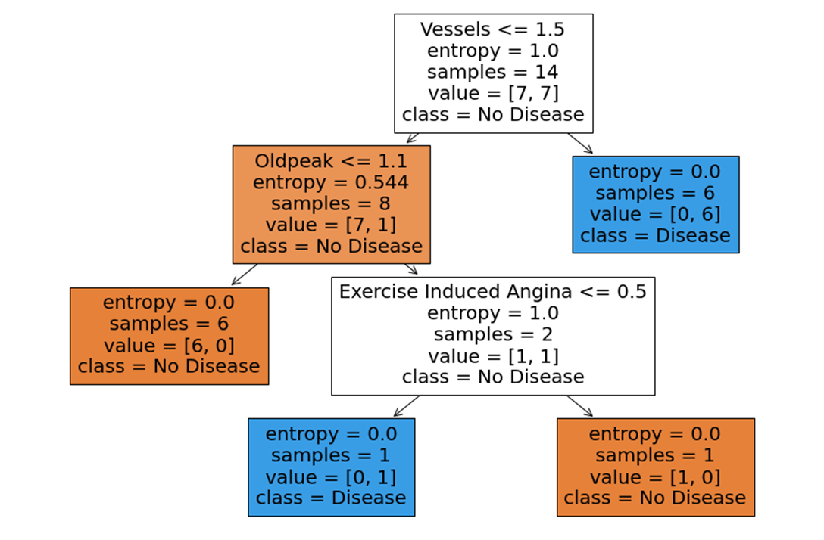
ID3

Slide 16

How I can read the ID3

Slide 17
06
Evaluation

Slide 18
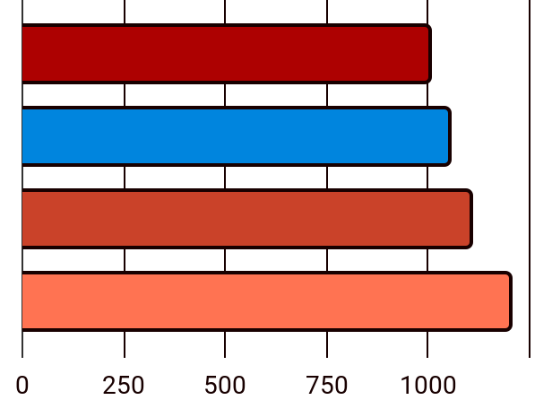
What This Code Does:
Dataset
Decision Tree
Evaluation

Slide 19

Evaluation

Slide 20
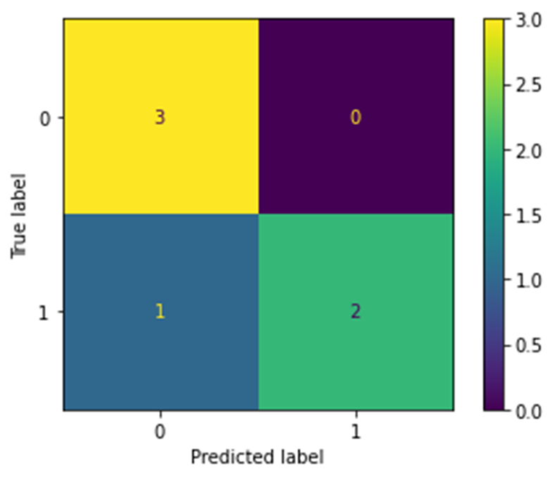
Evaluation metrics
1.Confusion Matrix
Accuracy: 83.33% of the predictions were correct.
Precision: 75% of predicted heart disease cases were accurate.
Recall: The model identified 100% of the actual heart disease cases.
F1-Score: 0.857, indicating a balanced performance.

Slide 21
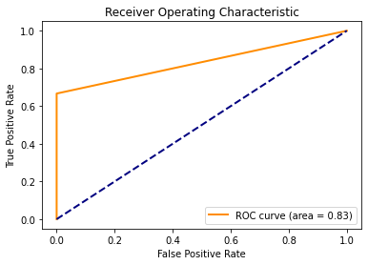
ROC
2.ROC
Area Under the Curve (AUC):
AUC = 0.83 > 0.5
=>
The model has good discriminatory ability

Slide 22
07
Conclusion

Slide 23

Conclusion

Slide 24
08
Code

Slide 25
THANK YOU

